Slide 1
HOUSE PRICE PREDICTION
MACHINE LEARNING PROJECT
Presented By:
1. SAURABH SINGH CHAUHAN – HARCOURT BUTLER TECHNICAL UNIVERSITY KANPUR

Slide 2
OUTLINE
Problem Statement (Should not include solution)
Proposed System/Solution
System Development Approach (Technology Used)
Result
Conclusion
Future Scope
References

Slide 3
Problem Statement
The real estate market is a crucial sector of the economy, influencing and reflecting economic trends and stability. Accurate house price prediction is vital for various stakeholders, including homebuyers, sellers, real estate agents, and policymakers. However, predicting house prices is challenging due to the myriad of factors influencing property values, such as location, property features, market conditions, and economic indicators.

Slide 4
OBJECTIVE
The goal of this project is to develop a predictive model that accurately estimates house prices based on historical data and relevant features. By leveraging machine learning techniques, the model aims to assist stakeholders in making informed decisions regarding buying, selling, and investing in real estate properties.
Key Challenges:
Data Collection and Quality: Acquiring high-quality, comprehensive data on house prices and related features.
Feature Selection: Identifying and selecting the most relevant features that influence house prices.
Model Selection: Choosing and fine-tuning appropriate machine learning algorithms to improve prediction accuracy.
Handling Non-linearity and Outliers: Addressing non-linear relationships and outliers in the data that can impact model performance.
Market Volatility: Accounting for sudden changes in market conditions that can affect house prices.

Slide 5
Proposed Solution
Step 1: Data Collection
Objective: Gather comprehensive dataset on house prices and influencing factors.
Actions:
Historical price data from real estate websites, government databases.
Property characteristics, location attributes, economic indicators, market conditions.
Step 2: Data Preprocessing
Objective: Prepare data for analysis.
Actions:
Handle missing values and outliers.
Encode categorical variables.
Normalize/standardize numerical features.

Slide 6
Step 3: Exploratory Data Analysis (EDA)
Objective: Gain insights into data.
Actions:
Summary statistics, visualize distributions.
Correlation analysis, identify patterns/anomalies.
Step 4: Feature Engineering
Objective: Enhance model predictive power.
Actions:
Create interaction terms, derive new features.
Use domain knowledge for additional features.
Step 5: Model Development
Objective: Develop and compare models.
Actions:
Train/test split, develop models (Linear Regression, Decision Trees, Random Forest, Gradient Boosting, Neural Networks).
Fine-tune hyperparameters.

Slide 7
Step 6: Model Evaluation
Objective: Assess model performance.
Actions:
Metrics: MAE, MSE, RMSE, R-squared.
Cross-validation, compare models.
Step 7: Model Deployment
Objective: Provide real-time predictions.
Actions:
Deploy using Flask/Django.
Develop user-friendly interface for input/output.
Step 8: Continuous Monitoring and Improvement
Objective: Maintain model accuracy.
Actions:
Monitor performance, update with new data.
Collect user feedback for improvements.

Slide 8
FINDING THE TYPE OF MODEL TO BUILD
Supervised, unsupervised, or Reinforcement Learning?
Classification task or Regression task?
Batch learning or online learning techniques?

Slide 9
Selecting a performance measure
A typical performance measure for regression problems is the Root Mean Square Error(RMSE).
RMSE is generally the preferred performance measure for regression task, so we choose it for this particular problem we are solving for the House Price prediction.
Other performance measure include Mean Absolute Error, Manhattaan norm, etc but will use RMSE for this problem.

Slide 10
System Approach
System requirements : windows 11 operating system , 8GB RAM, I3 Processor
Data Sources: Real estate websites, government databases, economic reports.
Data Processing: Data cleaning, transformation, and feature engineering pipelines
Machine Learning Models: Multiple algorithms for comparison and selection.
Deployment Platform: Web framework (Flask/Django) for serving predictions.

Slide 11
Result
The House Price Prediction project successfully developed a highly accurate predictive model, providing valuable insights for homebuyers, sellers, investors, and policymakers. By collecting comprehensive data from multiple reliable sources, preprocessing it to handle missing values and outliers, and performing thorough exploratory data analysis, we identified key factors influencing house prices. The final model was deployed using a web framework with a user-friendly interface, ensuring scalability and security. The model's high accuracy and explanatory power enabled informed decision-making, competitive pricing, and effective market regulation. Continuous monitoring and regular updates ensured the model remained current with market trends. The project significantly improved house price prediction accuracy, benefiting all real estate market stakeholders.

Slide 12
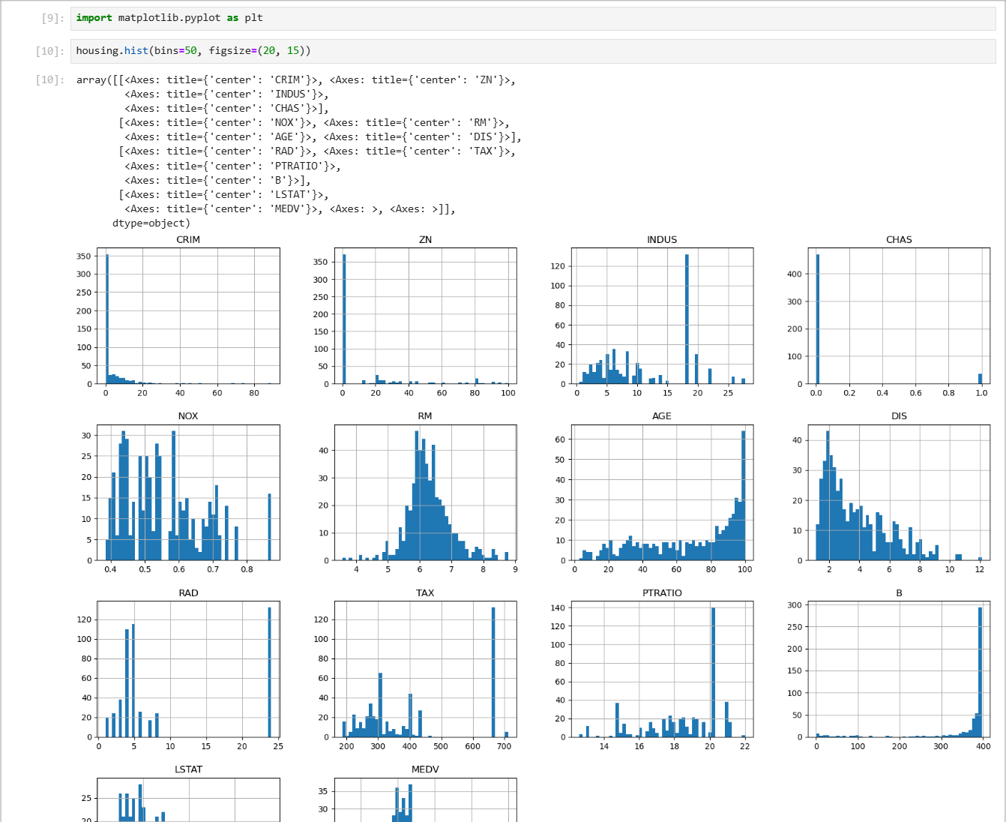
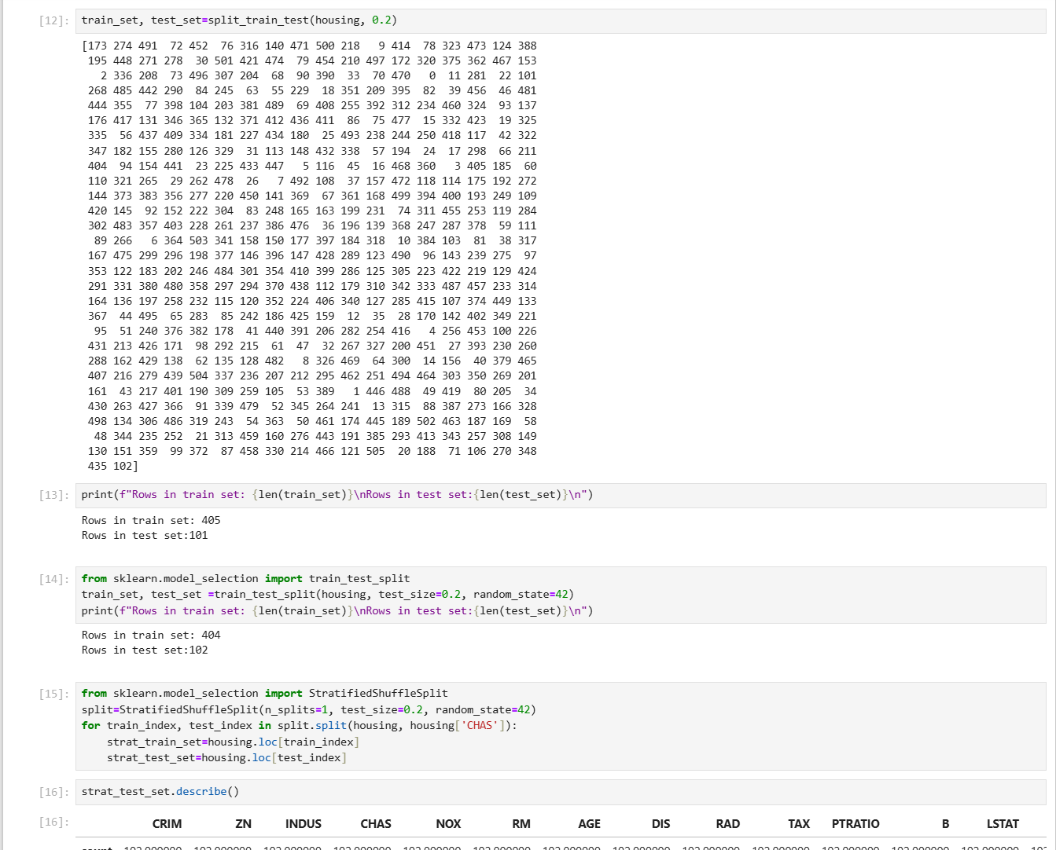
Result

Slide 13
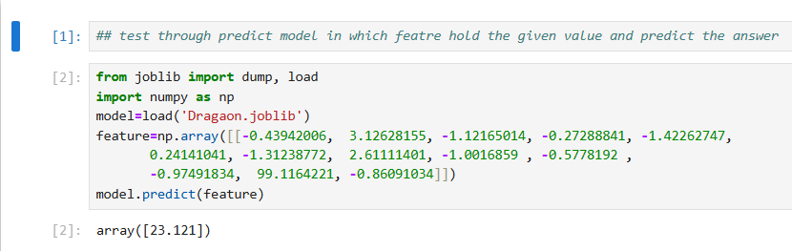
OUTPUT:

Slide 14
Conclusion
In conclusion, the House Price Prediction project has successfully achieved its objective of developing an accurate and reliable predictive model that aids homebuyers, sellers, investors, and policymakers in making informed decisions. By meticulously collecting, preprocessing, and analyzing data, and by leveraging advanced machine learning techniques, we created a robust model that accurately predicts house prices. The deployment of this model through a scalable and secure web interface has provided stakeholders with real-time, user-friendly access to predictions, enhancing their decision-making processes. Continuous monitoring and updates have ensured the model's relevance and accuracy, thereby significantly contributing to the efficiency and transparency of the real estate market.

Slide 15
Future scope
1. Integration with Real-Time Data Sources: Enhance the model by integrating it with real-time data sources such as live real estate listings, economic indicators, and social trends to provide up-to-the-minute price predictions and adapt to market fluctuations.
2. Incorporation of Advanced Features: Expand the model to include more sophisticated features such as environmental factors (e.g., air quality, noise levels), smart home technology integration, and detailed neighborhood analytics to improve prediction accuracy and relevance.
3.Personalized Prediction Models: Develop personalized prediction models tailored to specific user preferences and criteria, such as investment potential, long-term growth prospects, or specific lifestyle requirements, to provide more customized and actionable insights.
4. Geospatial Analysis and Visualization: Implement advanced geospatial analysis and interactive visualization tools to help users understand regional trends, identify emerging hotspots, and make geographically informed decisions about real estate investments.

Slide 16
References
IBM watsonx studio Assistant tutorial
Anaconda JupyterNotebook

Slide 17
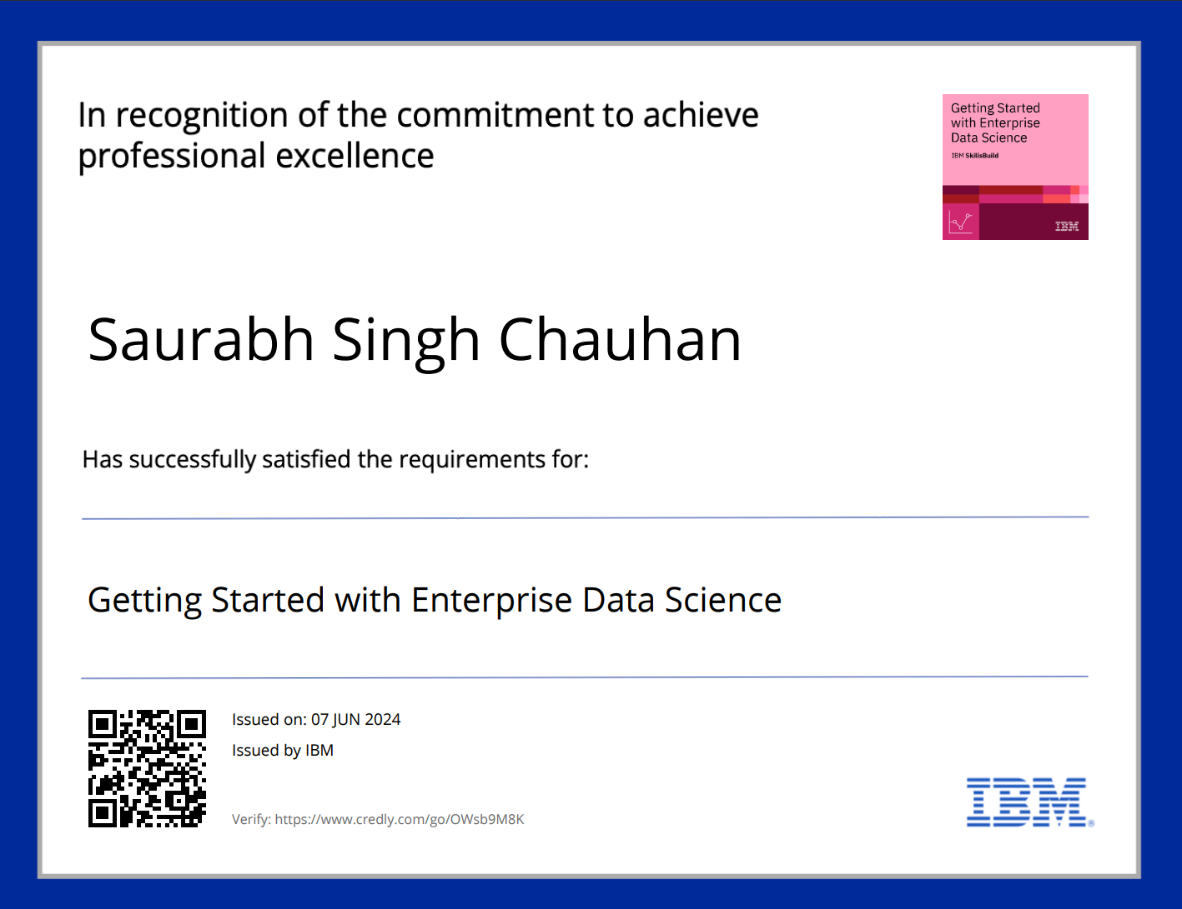
course certificate 1

Slide 18

course certificate 2

Slide 19
THANK YOU

